Slide 1

Arsenic
Human Health and the Environment

Slide 2

Introduction to Arsenic
Arsenic
Good Element – Bad Chemistry
Good Element – Bad Chemistry

Slide 3
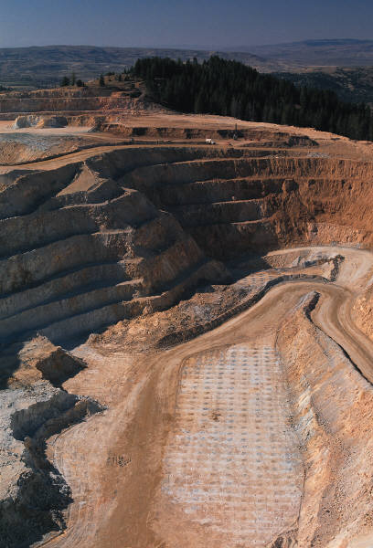
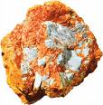
What is Arsenic?
Arsenic is an element which occurs naturally in the environment.
It combines with other metals and chemicals to make minerals in ores.
It is associated with the mining of other metals; copper, silver, gold.

Slide 4

Importance of Studying Arsenic
Arsenic is all around us.
It can not be destroyed – element.
It has toxic effects at both high and low exposure levels.
Arsenic is categorized as a human carcinogen (cancer causing).
Exposure to arsenic may affect children – lifetime toxic effect.

Slide 5
The Many Forms of Arsenic
Inorganic arsenic - Does not contain carbon but may contain other elements such as oxygen, chlorine, and sulfur.
Organic arsenic - Contains carbon and/or hydrogen.
Inorganic Arsenic
Poisonous (toxic) form
Organic Arsenic
Nonpoisonous (less toxic) form

Slide 6
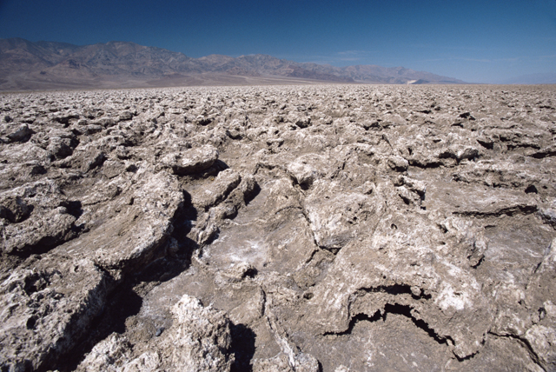
Inorganic Arsenic
Sources of arsenic in surface and ground water.
Found in mining and industrial waste.
Naturally occurring in soil and rocks.
Also used as a wood preservative (chromated copper arsenate) and leukemia treatment (Arsenic trioxide).

Slide 7


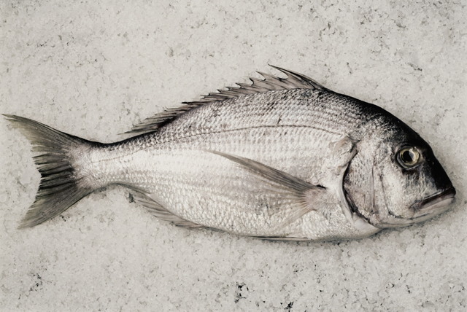
Organic Arsenic
Bacteria, fungi, and some plants convert inorganic arsenic to organic arsenic compounds.
Varying amount are found in living organisms:
  Animals
  Plants
  Seafood
Also used in pesticides/insecticides (monosodium methanearsonate) and poultry feed additive (3-Nitro).

Slide 8



Arsenic Toxicity – Historical Cases of International Arsenic Poisoning
The Borgias
Napoleon
Seen in movies and books
Several high-profile, intentional arsenic poisonings!
Arsenic: odorless, tasteless, and potent.
Most known poison.

Slide 9

Arsenic Uses
Ancient Uses
Current Uses
Pigment – dye
Medicine – for infection
Tanning – leather
Skin whitener
Wood preservative
Insecticide
Defoliant – cacodylic acid makes plants drop their leaves
Semiconductor – gallium arsenide
Medicine – arsenic trioxide is a treatment for leukemia

Slide 10
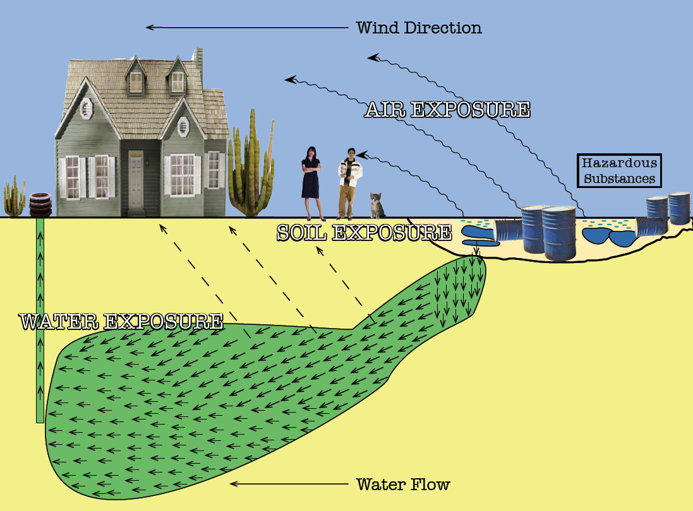
Exposure Pathways

Slide 11
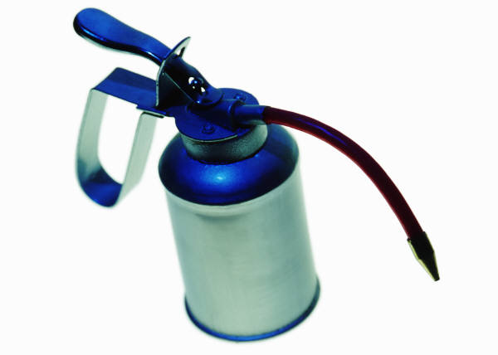
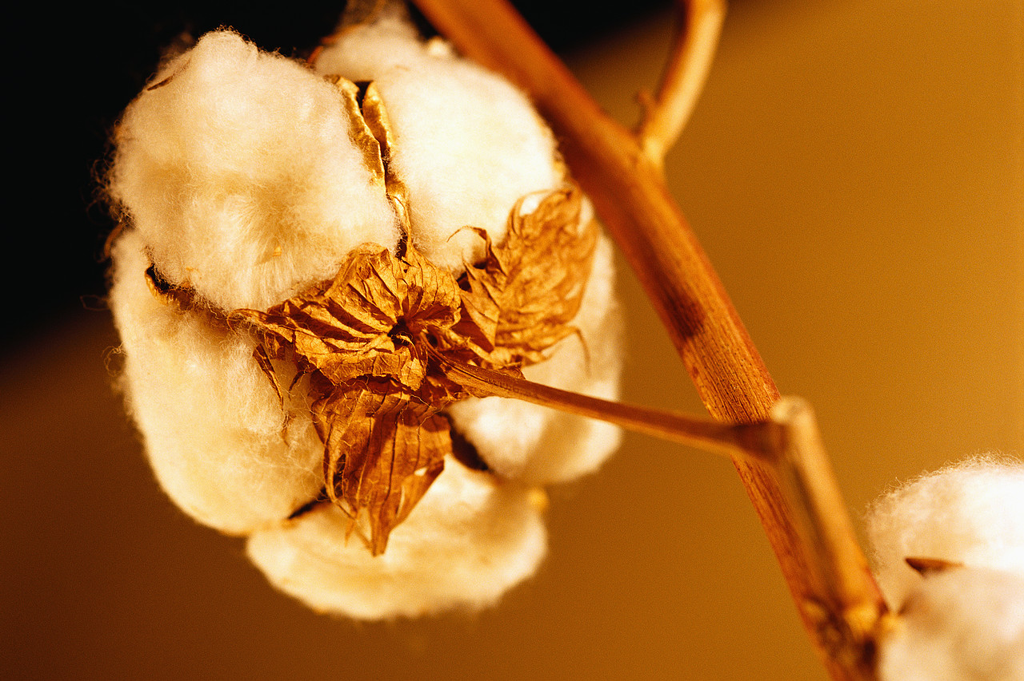
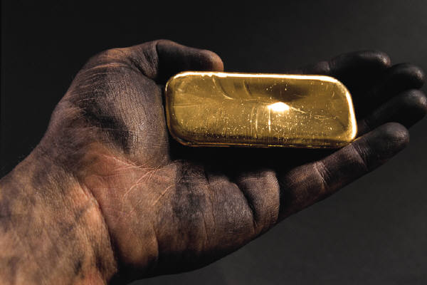
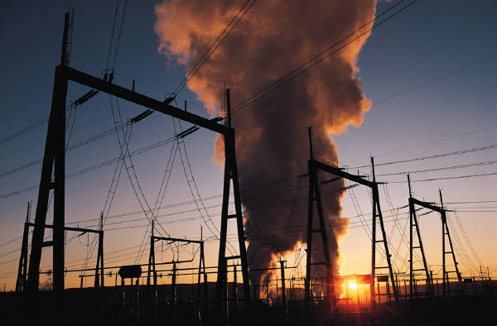
Sources of Arsenic Exposure
Routes of Exposure:
  Inhalation
  Water
  Food
It is wide spread in the environment:
  Pesticides
  Industry
  Minerals/Ores

Slide 12



Routes of Arsenic Exposures
Arsenic
Food
Dust
Complexed Form
Natural Form
Water Soluble Form
Water
Route:
Arsenic Type:

Slide 13

Arsenic is Naturally Occurring in our Waters
Drinking water with arsenic is the most common route of exposure!
Maximum contaminant levels:
U.S. = 10 ppb
Mexico 25 ppb

Slide 14

Arsenic Toxicity
It can make you sick!!!

Slide 15

How Long is Arsenic in the Body?
Single Dose
Every Day (weeks → years)
Cleared in 1-3 days.
Mainly via urine.
Accumulate in:
  Bones
  Hair
  Nails
  Organs (not in large amounts)
    Kidney
    Liver

Slide 16

Arsenic Poisoning: Effects of a High (Acute) Dose Exposure
All at once, not over a long period of time
Tired
Stomach Pains
Dryness in throat – hoarse/difficult to speak
Vomit – streaked with blood
Diarrhea
Difficult in urinating – burning
Convulsions – twitching and shaking rapidly and uncontrollably
Delirium
Death

Slide 17
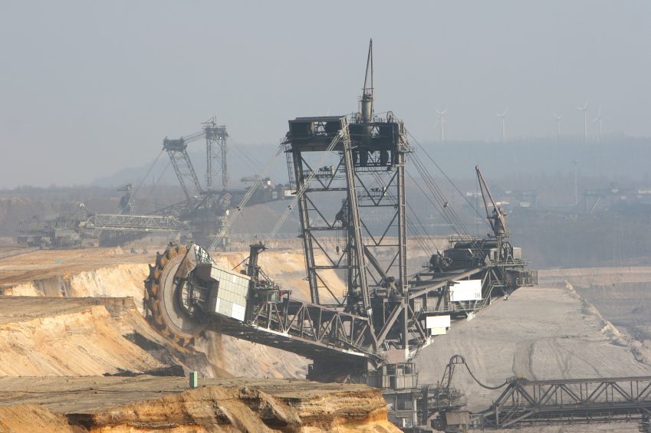
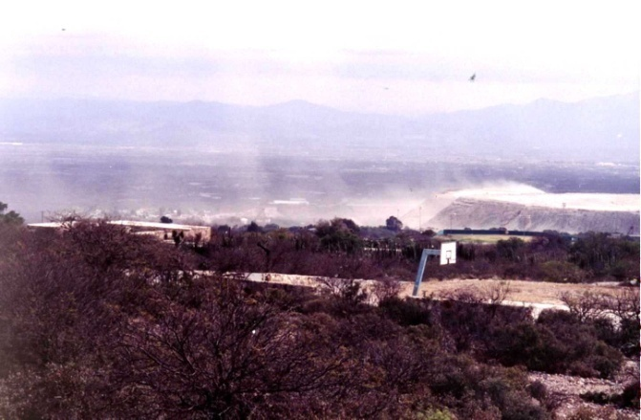
Our Biggest Problem with Arsenic: Long-term (Chronic), Low Level Exposure
Occupational:
  Industrial
Environmental:
  Drinking water – the government regulates water arsenic levels.
  Food – seafood, rice, etc.
  Dust – breath particles with arsenic.

Slide 18
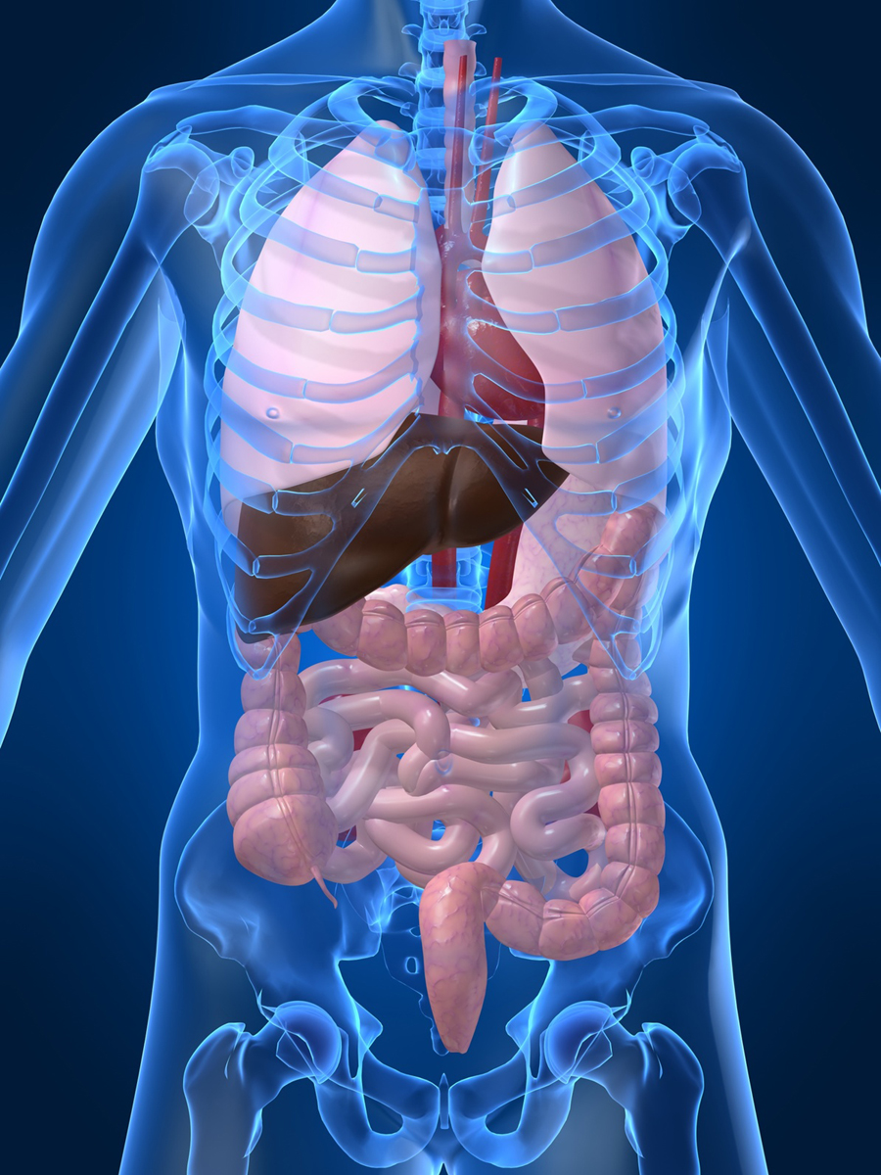
How Much is TOO Much Arsenic?
How much low-level, long-term arsenic exposure is BAD?
Skin cancer, thick skin, discolored skin
Elevated blood pressure, diabetes
Lung and heart development
Bladder, kidney, and liver cancer

Slide 19

Your Body’s Response to Different Doses of Arsenic
Very Sick
May Die
100
Responses
50
Cancer, birth
defects, diabetes
Sick, weight loss,
skin lesion
0
Low (Environmental)
Dose
Months/Years
Exposure
Medium Dose
Weeks Exposure
High Dose
Short Time

Slide 20
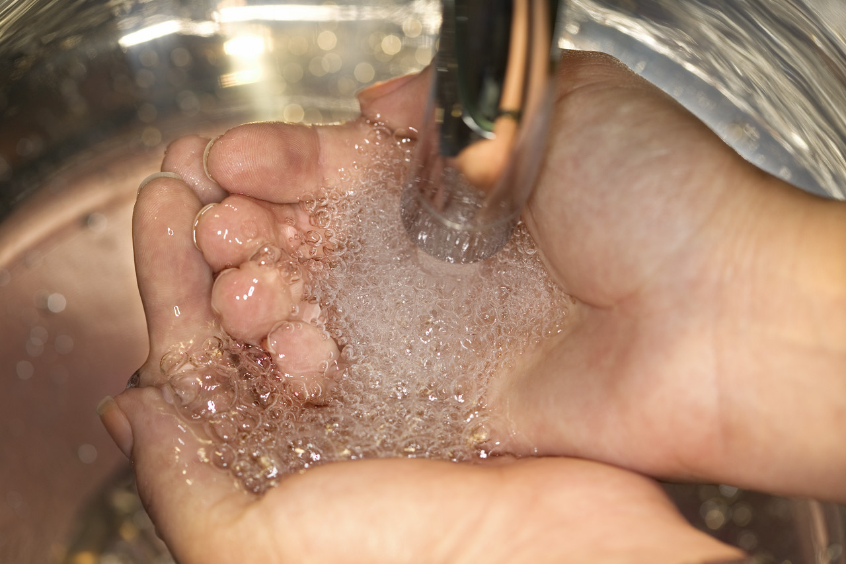


How can you Reduce Exposure!
Behavioral changes:
  Wash hands
Treatment technologies:
  Adsorption media and reserve osmosis
Cleaning techniques:
  Wet sweeping or dusting
Consumer Choices:
  Reduce use of arsenic containing pesticides
  Get rid of pressure treated wood products
  Food choices

Slide 21
Are we safe?
Arsenic Environmental Containing Pollutants
What are you going to do about them?

