Slide 1
The Chemistry of Copper Electrolysis

Slide 2
Objectives
Apply basic chemistry principles to understand the process of electrolysis
Understand how electrolysis is used in the processing of copper ores

Slide 3
Electrolysis
Uses an electrical current to move ions in an electrolyte solution between two electrodes
In copper electrolysis, when current is applied, copper ions (Cu²⁺ cations) leave the anode (+electrode) and move toward the cathode (-electrode)
+
-
Cu²⁺
Anode
(impure copper)
Cathode (pure copper)
CuSO₄ Solution

Slide 4
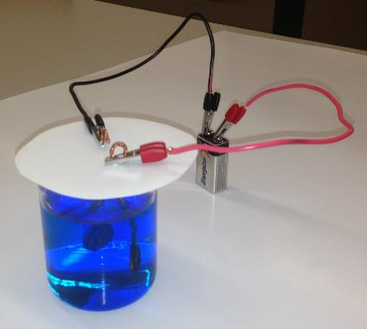
Lab-scale Electrolysis
In this experiment, a penny will be used as the copper source/anode, and a dime will be used as the cathode
They will be placed in an electrolyte solution
A current will be supplied by a 9V battery

Slide 5
Hypothesis
What do you think will happen in this experiment?
Write a hypothesis on worksheet

Slide 6
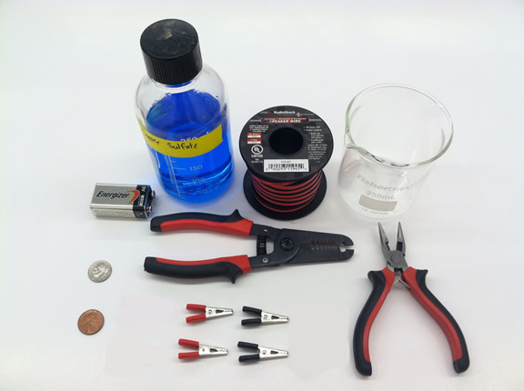
Materials
Don’t forget safety goggles and gloves!
Notes:
Copper sulfate electrolyte solution (200 g CuSO4· 5H2O + 25.0 mL concentrated H2SO4 solution in enough distilled or deionized water to make 1.0 L of solution)
Coin cleaning solution (1 tsp table salt dissolved in ¼ cup vinegar)
Pre-1982 penny (contains 95% copper, versus only 2.5% copper post-1982)
Dime (any year)
9V battery (use a new 9V battery for each experiment)
18-gauge copper wire
Four alligator clips (2 each of red and black)
Wire stripper and needle-nosed pliers
Two 250-mL beakers
Cardboard circle (approx. 15 cm diameter)
Precision scale (optional)

Slide 7
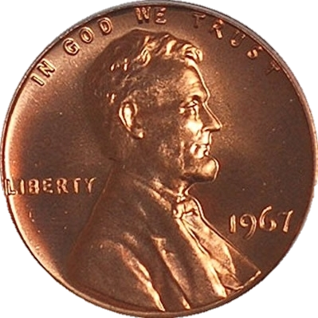
Protocol
Clean a pre-1982 penny with salt/vinegar mixture, rinse with water and allow to dry
Notes:
Optional: ask students why they think the year of the penny matters?
(Pre-1982 penny contains 95% copper, versus only 2.5% copper post-1982)

Slide 8
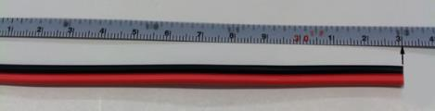


Protocol
Cut a 33 cm length of 18-gauge copper wire
Peel apart to separate red- and black-coated wires
33cm
Notes:
This slide can be left out if instructor prefers to prepare the wires ahead of time

Slide 9
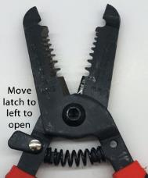
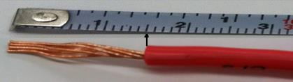
Protocol
Use 1.6 mm gauge setting on wire stripper to remove ~1.5 cm length of rubber coating from both ends of each wire to expose the copper filaments, being careful not to sever copper filaments
Notes:
This slide can be left out if instructor prefers to prepare the wires ahead of time

Slide 10
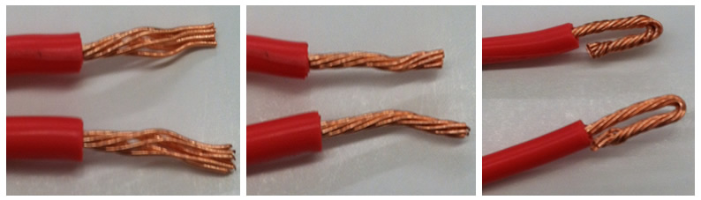
Protocol
Twist filaments together tightly and fold
A
B
C
A) Exposed copper filaments; B) twisted copper filaments; and C) final product of twisted and folded copper filaments.
Notes:
This slide can be left out if instructor prefers to prepare the wires ahead of time

Slide 11
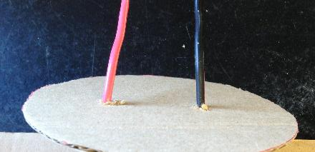
Protocol
Make two holes in the cardboard an inch apart
Push the red wire through one hole and the black wire through the other

Slide 12
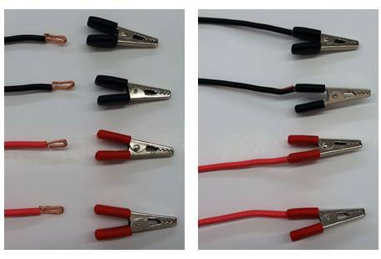
Protocol
Insert each folded end of wire into handle of matching alligator clip so that wire touches metal inside the clip handle → red wire should have a red alligator clip at each end; black wire should have a black alligator clip at each end
A
B
A) Unattached copper wires; B) copper wires attached to alligator clips.

Slide 13
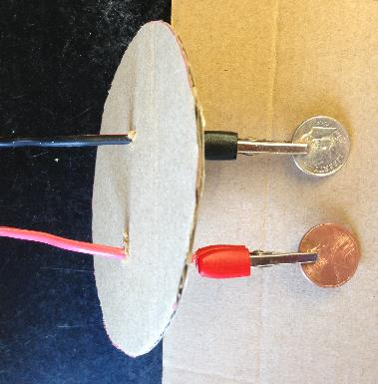
Protocol
Clip the penny into the red electrode and clip the dime into the black electrode
Complete wire assembly: red and black wires pushed through cardboard with alligator clips attached and coins inserted.

Slide 14
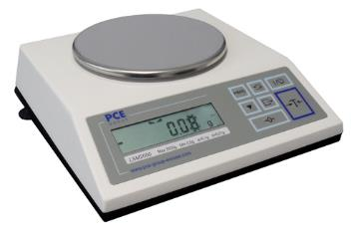
Protocol
OPTIONAL step to be completed before inserting wires into cardboard:
Weigh each coin/copper wire assembly separately and record the mass
  Penny/red wire/red clips
  Dime/black wire/black clips

Slide 15
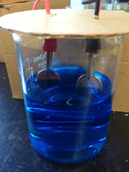
Protocol
Pour 200 mL of the copper sulfate electrolyte solution into the beaker
Place the wire assembly over the beaker so that the coin "electrodes" are immersed in the electrolyte solution
Note: the two electrode assemblies must not touch one another.

Slide 16
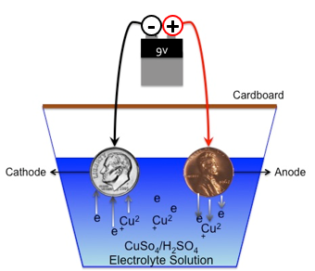
Protocol
Clip each connecting wire to the 9V battery:
  Clip red to positive terminal
  Clip black to negative terminal

Slide 17
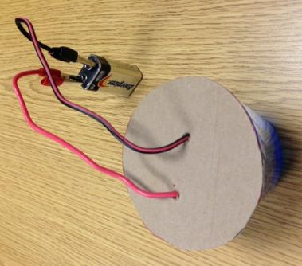
Protocol
Allow the electrolytic cell to operate for 30-60 minutes
OPTIONAL: Record the length of time the cell was operating

Slide 18
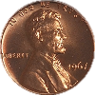
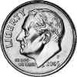
Protocol
Carefully remove wire assemblies and hang in an empty beaker until dry (5-10 min), being careful not to touch coins, so as not to lose any of the copper plating

Slide 19
Protocol
Examine the coins for changes
OPTIONAL: Weigh each coin/copper wire assembly and record the mass. Calculate the difference in starting and ending mass.
Notes:
Encourage students to describe the changes they see. Were their hypotheses correct?

Slide 20
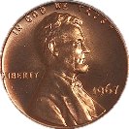
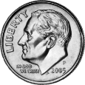
Lab Results
Initial mass of penny [g] |  | Initial mass of dime [g]
Final mass of penny [g] |  | Final mass of dime [g]
Difference in mass [g] |  | Difference in mass [g]
Notes:
This slide is OPTIONAL, if the students weighed the coin/wire assemblies before and after.
The instructor can fill in the measured masses on this slide – either choose a single group, or an average of all the groups, or fill in a slide form each group and compare. See the next slide for an example of what you might measure.
Is the mass lost from the penny equal to the mass gained from the dime? Ask the students to discuss why they might be different.

Slide 21
Lab Results (Example)
Initial mass of penny [g] | 4.764 | Initial mass of dime [g] | 3.549
Final mass of penny [g] | 4.371 | Final mass of dime [g] | 3.988
Difference in mass [g] | -0.393 | Difference in mass [g] | +0.439
Notes:
This slide is an example of values that might be measured when students weight the coin/wire assemblies before and after.

Slide 22
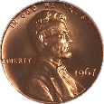

Electrolysis Explained
Coating the dime with copper from a penny
  When electrical current is applied to the penny (anode), copper cations are set free in the electrolyte solution.
  Cu²⁺ ions in solution are attracted to the dime (cathode).
Anode
Positive Electrode
Cu _{(solid)} → Cu²⁺_{(aqueous)} + 2 e-
Cathode
Negative Electrode
Cu²⁺_{(aqueous)} + 2 e- → Cu_{(solid)}

Slide 23
Real-Life Copper Electrolysis
Anode slabs of impure copper are hung in a large tank
  Act as positive electrodes
Thin “starter sheets” of pure copper (15 lb) are hung in between anodes
  Act as cathodes/negative electrodes
Tank is filled with electrolyte solution
  Copper sulfate and sulfuric acid
Electric current is applied (over 200 amperes)
Notes:
Students can discuss similarities and differences between the experiment they performed and full-scale electrolysis used in copper production.

Slide 24
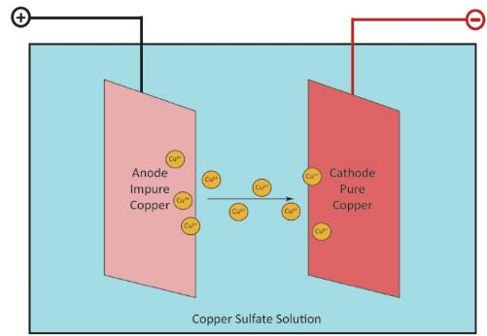
Real-Life Copper Electrolysis
Positively-charged copper ions (cations) leave the anode (positive electrode)
Cations move through the electrolyte solution and are plated on the cathode (negative electrode)
Notes:
Students can discuss similarities and differences between the experiment they performed and full-scale electrolysis used in copper production.

Slide 25
Real-Life Copper Electrolysis
Other metals and impurities also leave the anodes
  Drop to the bottom of the tank or stay in solution
  Can be collected and refined to recover other valuable metals such as silver and gold
After 1-2 weeks of electrolysis, the final products are copper cathodes
  Weigh 375 pounds
  Contain 99.99% pure copper
Notes:
Students can discuss similarities and differences between the experiment they performed and full-scale electrolysis used in copper production.

Slide 26
Questions
At the end of the experiment, the dime should be coated with copper.
  What are the possible sources of this coating? How could you determine which sources contributed to the coating, and how much?
Why do you think copper wire is used for the wire assemblies?
What differences would you expect if the electrolytic experiment were allowed to run for a short time versus a long time?

Slide 27
Questions
What would you expect to see if you made the dime the anode and the penny the cathode, and/or used different coins in the experiment? Would you need to change anything else?
To reach commercial scale, how do you think you would need to change the materials from this small experiment to make a 375-pound copper cathode?

