Slide 1
Copper Mining and Processing

Slide 2
Learning Objectives
Describe basic information about copper, its occurrence, and its use
Articulate the history and current status of copper mining in Arizona and tribal lands
Detail the stages in the life cycle of a mine
Describe copper processing for oxide and sulfide ores

Slide 3
Copper, its Occurrence, and Use
What is Copper?

Slide 4
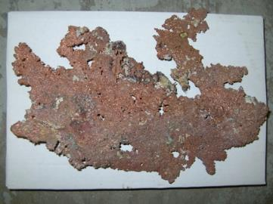
What is Copper?
Reddish-orange bright metallic luster
Found as native (pure) copper or combined with other elements
Ductile and malleable
Copper
29
Cu
63.54
Good conductor of heat and electricity
Resistant to corrosion
Can be alloyed to make bronze and brass

Slide 5
Copper, its Occurrence, and Use
Naturally Occurring Forms of Copper

Slide 6
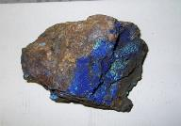
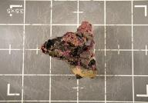
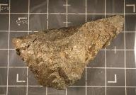
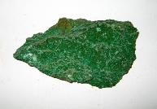
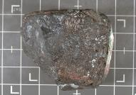
Forms of Copper
Native (pure) copper
Copper sulfides (e.g. chalcopyrite and chalcocite)
Copper oxides (e.g. cuprite)
Copper carbonates (e.g. azurite and malachite)
Azurite
Cuprite
Chalcopyrite
Malachite
Chalcocite
Notes:
Copper sulfide and oxide ores are the forms most commonly mined for copper

Slide 7
Copper Ores
Copper ores are complex
  Can contain metals, other elements, and non-metallic minerals
In the ore, copper is less than 1%
Depending on the ore, it requires different mining and extraction processes to yield 99.99% pure copper

Slide 8
Copper, its Occurrence, and Use
Historical and Modern Copper Use

Slide 9
Historical Copper Use
Discovered: early 9000 BC in Middle East
Early artifacts used native (pure) copper
  Utensils, tools, weapons, piping, ornaments, and jewelry
Chalcolithic period: ~3500-2500 BC
  Rise in the use and smelting of copper
  Discovery of bronze alloy
  Early Romans discovered brass alloy
  Copper and brass as currency

Slide 10
Historical Copper Use in the US
  Largest deposit of native copper found in Michigan at Keweenaw mines
  Native Americans mined copper~5000–1200 BC
  Found as knives, arrows, spear heads, and axes throughout Americas
  Copper not mined on a commercial scale until 1840s

Slide 11


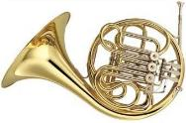

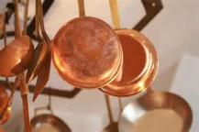
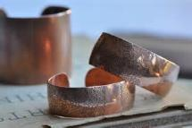
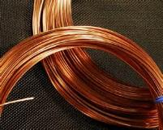
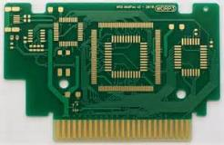
Copper in our Modern Lives
Common copper alloys are bronze and brass
Currency
Cooking pots
Wiring/Electronics
Jewelry
Notes:
bronze (e.g., statues) and brass (e.g., French horn)

Slide 12
Major Modern Copper Uses
Copper consumption by major U.S. markets in 2013. Source: Copper Development Association Inc. Annual Data (2014).

Slide 13
World Consumption of Copper
Worldwide consumption of copper has increased greatly over the past century
Leading consumers¹:
  Asia
  Europe
  The Americas
Leading producers² (tons/year):
  Chile (5.7 million)
  China (1.7 million)
  Peru (1.3 million)
  US (1.2 million)
  Australia (1 million)
Source: ¹ IWCC, 2013; ² USGS, 2014

Slide 14
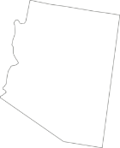

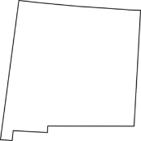


US Copper Production
In the United States, approximately 99% of the $9 billion dollars’ worth of copper produced comes from five states: Arizona, Utah, New Mexico, Nevada, and Montana
NEW MEXICO
ARIZONA
UTAH
NEVADA
MONTANA
Source: USGS, 2014

Slide 15

Copper Mining in Arizona
Arizona Copper Production

Slide 16
Arizona: The “Five C’s”
Cattle
Cotton
Citrus
Climate
Copper

Slide 17
Copper and the Arizona Economy
Arizona produces approximately 65% of the country’s copper¹
In 2011, copper mining contributed²:
  $4.6 billion direct and indirect economic benefits
  49,800 jobs
  Arizona is home to the Morenci Mine which is one of the largest in the world³
Source: ¹ USGS, 2014; ² AZ Mining Assoc., 2011; ³ Freeport-McMoRan, 2014

Slide 18
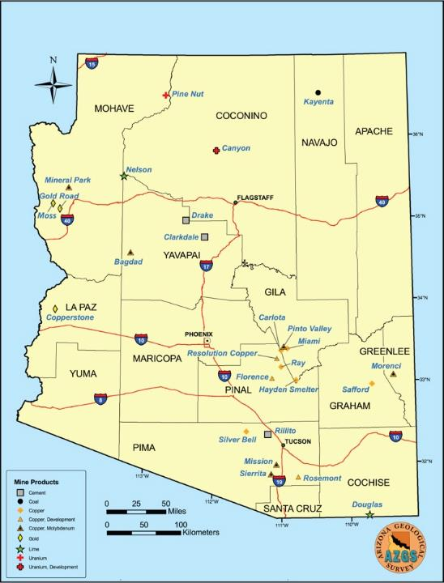
Arizona Major Mines in 2014
Adapted from Arizona Geological Survey Map 38 by Nyal Niemuth

Slide 19
Copper Mining in Arizona
Environmental Regulation

Slide 20
Environmental Regulation
Regulatory agencies ensure that mines do not release hazardous materials outside of mine site
  US Environmental Protection Agency
  AZ Department of Environmental Quality
  County Department of Environmental Quality
  Tribal Environmental Protection Agency
  Mining companies have personnel in place to interact with the regulatory agencies

Slide 21
Copper Mining on Tribal Lands
Arizona

Slide 22
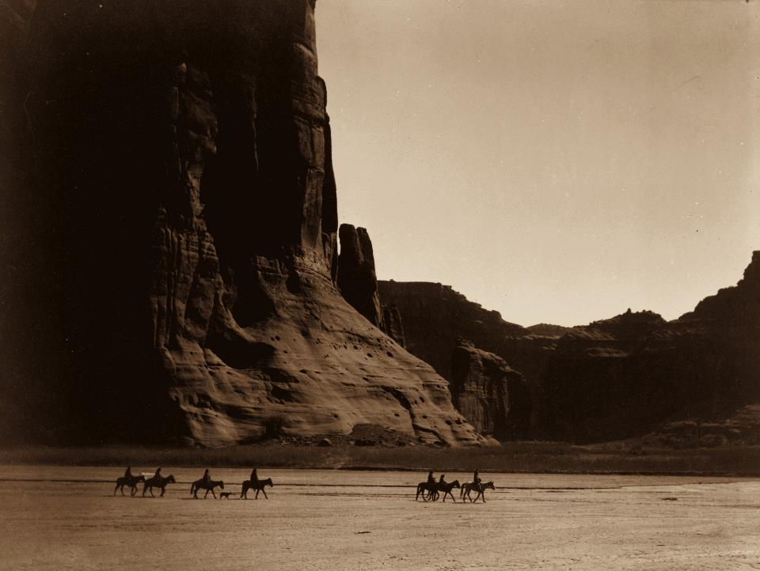
Mining on Tribal Lands
Twenty-one federally-recognized tribes own lands that cover 19.7 million of Arizona’s 72.9 million acres, or 27% of the state
"Canyon de Chelly, Navajo" by Edward S. Curtis - REPOSITORY: Library of Congress Prints and Photographs Division. Public Domain via Wikimedia Commons.

Slide 23
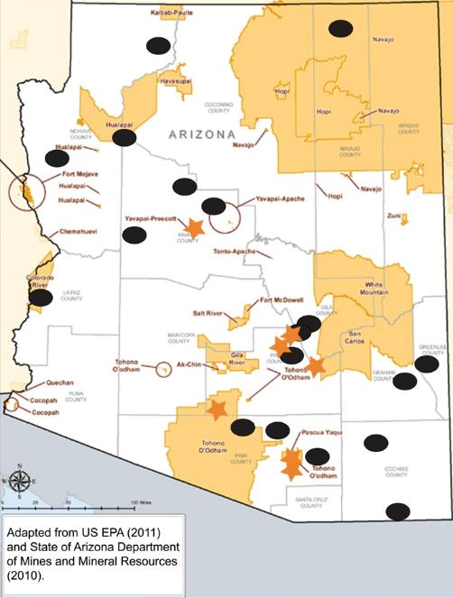
Major Mines and Tribal Lands

Slide 24
Copper Mining on Tribal Lands
Tohono O’odham Nation

Slide 25
Tohono O’odham Nation
Owns 2.7 million acres, or 3.7% of the state
Metallic minerals mined throughout history:
  Copper, gold, silver, lead, zinc, iron, mercury, manganese, uranium, and tungsten
Within Pima County portion of the Nation:
  ~210 metallic mineral deposits, mines, prospects, and quarries
  Many smaller mines are results of small-time prospectors and now abandoned
Mission Cu Mine

Slide 26
Copper Mining on Tribal Lands
Case Study #1: Mission Mine

Slide 27
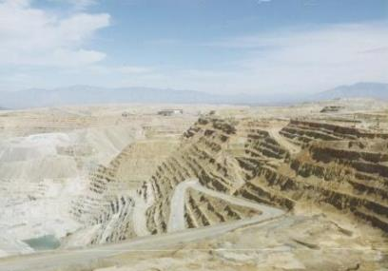
Mission Mine
19,000 acre mine located on the south end of San Xavier District
Current pit:
  2.5 miles long
  1.5 mile wide
  1,200 feet deep

Slide 28
Mission Mine
In 2012:
  Produced 134 million pounds of copper concentrate
  Paid $6.6 million in state royalties and $2.5 million in tribal royalties
  Employed 620 people
Expected to produce until 2033

Slide 29
Mission Mine
Violations for dust emissions and water discharges
Works with regulatory agencies to achieve compliance

Slide 30
Copper Mining on Tribal Lands
Case Study #2: Cyprus Tohono Mine

Slide 31
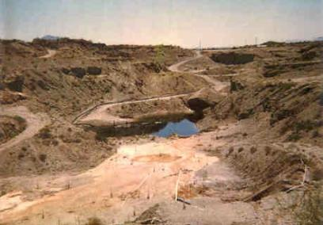
Cyprus Tohono Mine
4,180 acre mine located in the Sif Oidak District
Currently in care and maintenance mode, but may resume operations

Slide 32
Cyprus Tohono Mine
Listed as a Superfund Alternative site in 2009
  Groundwater contaminated with uranium, sulfate, and perchlorate
Agency for Toxic Substances and Disease Registry has completed a Health Consultation

Slide 33
Tribal Concerns with Mining

Slide 34
Tribal Concerns
Tribes have faced displacement, discrimination, and marginalization due to mining
Mining can be a source of contamination that impacts the health of neighboring communities and the environment

Slide 35
Tribal Concerns
Concerns may include:
  Poor air quality
  Contaminated water
  Occupational hazards which can be a result of direct exposure to dust during metal/mineral extraction
Enforcement of mine safety issues is regulated by the Mine Safety and Health Administration, a division of the US Department of Labor

Slide 36
Tribal Concerns
Mining can have impacts on sacred lands and artifacts as well as natural resources
  On the Navajo Nation people used uranium mill tailings to build their traditional earthen homes (hogan), many of which remain in use today
  100 sacred and cultural sites of the Tohono O’odham Nation may be impacted by the proposed Rosemont Copper Mine
  Lands sacred to the San Carlos Apache may be impacted by the proposed Resolution Copper Mine

Slide 37
Life Cycle of a Mine

Slide 38
Life Cycle of a Mine
Prospecting/ Exploration
Development
Extraction
Closure/ Reclamation
Prospecting/Exploration: Finding and defining it
Development:
Planning and building it
Extraction:
Mining it
Closure/Reclamation: Cleaning it up

Slide 39
Life Cycle of a Mine
Prospecting/Exploration (Finding and Defining it)
Prospecting/ Exploration

Slide 40
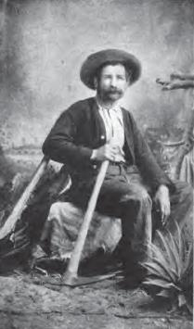
Prospecting/Exploration
Precursor to mining
Overlapping stages
~2-8 years total
~$500K-$15 million total
George Warren, American prospector in Bisbee, Arizona, who discovered the Queen Creek copper deposits.
"Prospector George Warren" by Unknown, published by S.J. Clarke Publishing Company (1916). Public Domain via Wikimedia Commons.

Slide 41
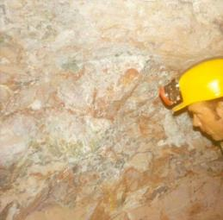
Prospecting
Geologic mapping
  Geophysics
  Geochemistry
  Drilling
  Photography and mapping
  May or may not lead to discovery of valuable minerals

Slide 42
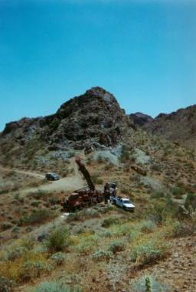
Exploration
Acquire mineral rights lease as needed
Additional techniques more accurately determine size and value of mineral deposit:
  Is it a mineral resource or ore reserve?
  Allows estimate of how much it is worth + how much will it cost to mine it
Notes:
.

Slide 43
Mineral Resource
Concentrated, potentially valuable material that can be mined for economic profit
Whether it is worth mining may depend on:
  Amount, form, location, and quality of the material (i.e., geological confidence)
Source: JORC, 2012

Slide 44
Mineral Resource
Geological methods classify a mineral resource according to geological confidence:
  Inferred
    Limited sampling, low confidence ore is there
  Indicated
    More sampling, some confidence ore is there, but still just an estimate
  Measured
    More sampling, high confidence ore is there and that estimate is accurate
Source: JORC, 2012

Slide 45
Ore Reserve
The part of the mineral resource that can be economically profitable to mine
  I.e., there is enough valuable metal to be worth extracting it from the surrounding rock
Source: JORC, 2012

Slide 46
Ore Reserve
Classified based on what is known about the mineral resource + “modifying factors”
  Factors include mining, metallurgic, economic, environmental, marketing, legal, political, and social considerations
  Probable
    Some confidence ore is there, some uncertainty in modifying factors → mine could be successful, but there is still some risk
  Proved
    High confidence ore is there, little uncertainty in modifying factors → mine is likely to be economically succesful
Source: JORC, 2012

Slide 47
General relationship between Mineral Resources and Ore Reserves
Exploration Results
Mineral Resource
(classified on geological confidence)
Ore Reserve
(classified on geological confidence + certainty of modifying factors)
Inferred
Limited sampling,
low confidence about what’s really there
  Increasing geological sampling/confidence
Indicated
More sampling,
more confidence,
but still an estimate
Probable
Some confidence in ore + some uncertainty in modifying factors
Measured
Additional sampling, high confidence estimate is accurate
Proved
High confidence in ore
+ little uncertainty in modifying factors
  Increasing Economic Favorability
Based on analysis of “modifying factors” including mining, metallurgic, economic, environmental, marketing, legal, political, and social considerations
Adapted from: Australasian Code for Reporting of Exploration Results, Mineral Resources and Ore Reserves. Source: JORC, 2012

Slide 48
Exploration
Final step: produce a feasibility report
  How much is the ore worth?
  How much will it cost to mine it?
  Bottom line: Is it a good investment to open this mine?
Mining organization can now make a decision about whether the project will be abandoned or continued…
Notes:
.

Slide 49
Life Cycle of a Mine
Development (Planning and Building it)
Development

Slide 50
Development
~4-12 years total
~$1 million - $1 billion
Extensive logistical planning and paperwork:
  Budget and financial reports prepared
  Permits requested
  Environmental and community impacts assessed

Slide 51
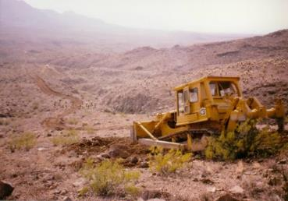
Development
Plans for infrastructure are assessed:
  Which mining process/ technology will be used
    Surface, underground, solution
  Building of access roads
  Identification of resources
    e.g., power and water sources
  Construction of ore processing facilities and disposal areas for waste

Slide 52
Development
Mine site is developed just enough to ensure it can be productive for the life cycle of the mine, without later interruption
By this stage, ~$10s of millions - $100s of millions may have been invested in the project
  …But it may fail to open if the pre-development requirements are not met, including acceptance by the community!

Slide 53
Life Cycle of a Mine
Extraction (Mining it)
Extraction

Slide 54
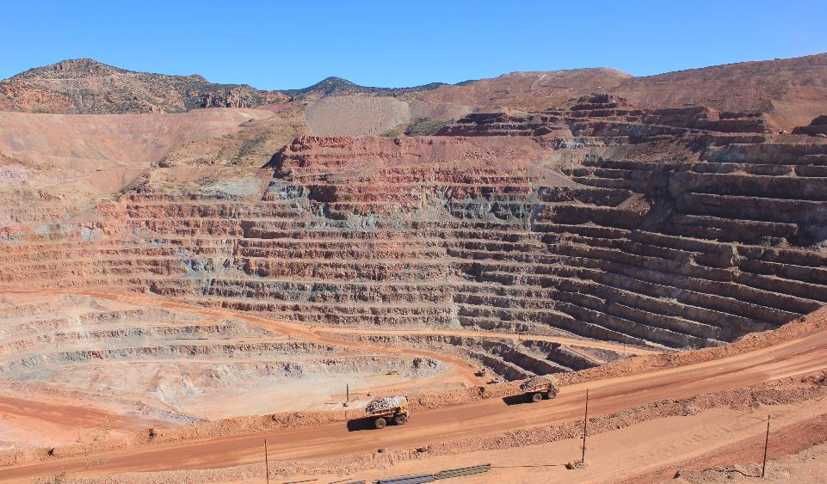
Extraction
  The mine begins producing, removing the mineral from earth in large quantities
    This is typically what we picture when we think of mining
"Morenci Mine 2012" by Stephanie Salisbury - IMG_4218. Licensed under CC BY 2.0 via Commons - https://commons.wikimedia.org/wiki/File:Morenci_Mine_2012.jpg#/media/File:Morenci_Mine_2012.jpg

Slide 55
Extraction
Typically ~5-30 years total
  But many mines are now open for 100+ years
Can cost ~$several million - $100s of millions per year
  Depends on size of mine, location, etc.

Slide 56
Life Cycle of a Mine
Closure/Reclamation (Cleaning it up)
Closure/ Reclamation

Slide 57
Closure/Reclamation
~1-5 years for closure and up to 35 years or more for reclamation
Can cost $millions - $100s of millions depending on many factors
  E.g., age, location, type, and size of mine, amount of waste, geological characteristics, and type of mineral

Slide 58
Closure/Reclamation
Planning for mine closure and reclamation begins early on:
  The mine is not allowed to open without a plan for closure in place already
  Federal and state regulations require mining companies to post funding for closure prior to the mining project beginning

Slide 59
Closure
Closure considerations include:
  Protecting public health and safety
  Addressing environmental damage
  Returning land to its original or accepted state
  Sustaining social and economic benefits brought by mine

Slide 60
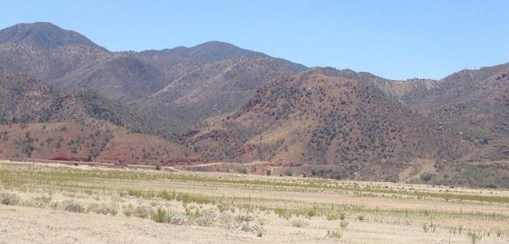
Reclamation
Reclamation plans describe the processes that will attempt to restore or redevelop the land that has been mined to a more natural or economically usable state

Slide 61
Processing of Copper Ores

Slide 62
Processing of Copper Ores
The copper ores undergo different processing depending on their chemistries
Mining
Transporting
Primary Crushing
Froth Floatation
Heap Leaching
Thickening
Solvent Extraction
Oxide Ore: Hydrometallurgy
Sulfide Ore: Pyrometallurgy
Smelting
Electrowinning
Final Product:
99.99% pure copper cathode
Electrolysis

Slide 63
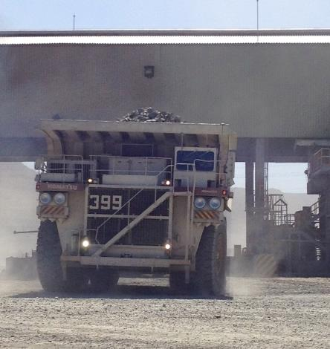
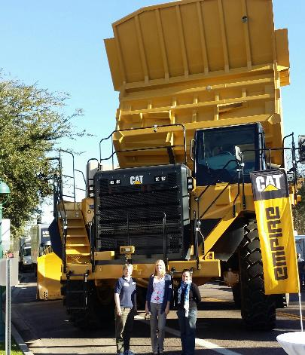
Mining and Transporting

Slide 64
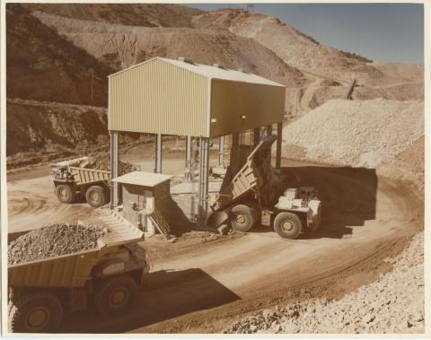
Primary Crusher
The primary crusher reduces the size of the ore from boulder to golf ball-sized rocks

Slide 65
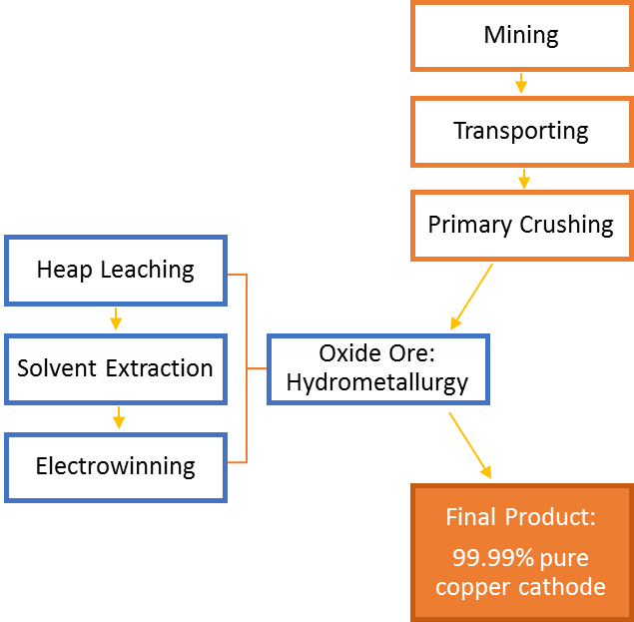
Processing of Oxide Ore
(For example, Cyprus Tohono Mine)

Slide 66
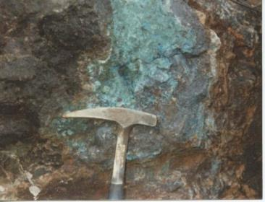
Processing Copper Oxide Ore
Oxide ores are generally processed using hydrometallurgy
Mining considerations:
  Oxide ore is usually lower-grade (contains less copper)
  Oxide ore is often more abundant near the surface
  Hydrometallurgy process is less expensive

Slide 67
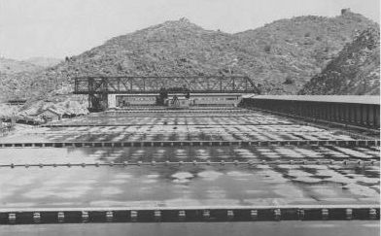
Hydrometallurgy
Uses aqueous (water-based) solutions to extract and purify copper from copper oxide ores, usually in three steps:
  Heap leaching
  Solvent extraction
  Electrowinning

Slide 68
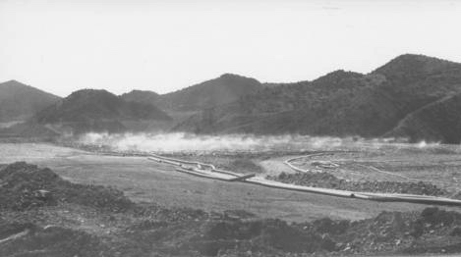
Heap Leaching
Uses percolating chemical
solutions to leach out
metals from the ore
Commonly used for low-
grade ore
Process consists of:
  Crushed ore is piled into a heap on a slope (impenetrable layer)
  Leaching reagent (dilute sulfuric acid) is sprayed and trickles though heap to dissolve copper from the ore
  Pregnant leach solution and copper sulfate is collected in a small pool
  Copper compound contains between 60-70% copper

Slide 69
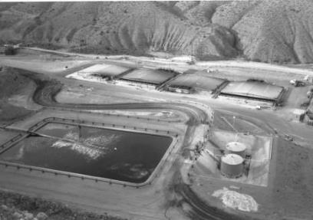
Solvent Extraction
Two immiscible (un-mixing) liquids are stirred and allowed to separate, causing the copper to move from one liquid to the other
  Pregnant leach solution is mixed with a solvent
  Copper moves from the leach solution into the solvent
  Liquids separate based on
  solubility
    Copper remains in solvent
    Impurities remain in the leach
    solution (which is recycled)

Slide 70
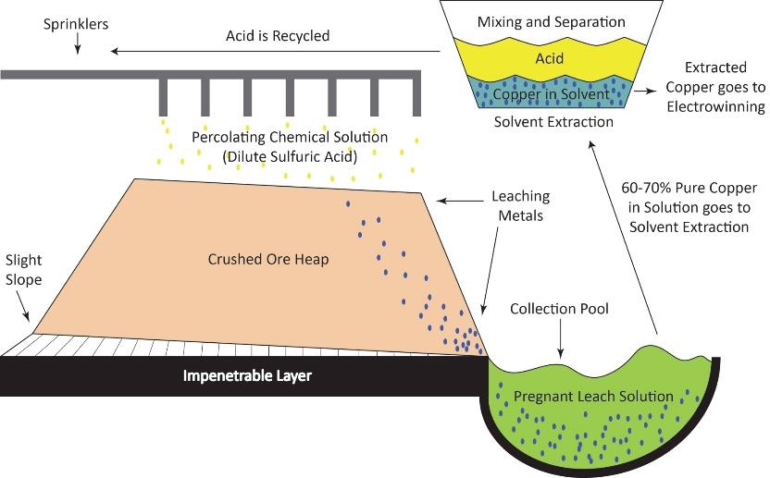
Heap Leaching and Solvent Extraction

Slide 71
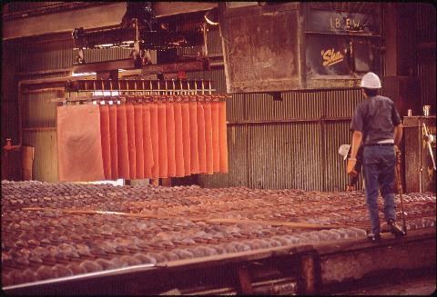
Electrowinning
Electrical current passes through an inert anode (positive electrode) and through the copper solution from the previous step, which acts as an electrolyte
Positively-charged copper ions (called cations) come out of solution and are plated onto a cathode (negative electrode) as ~99.99% pure copper
Electrowinning, Inspiration Consolidated Copper Co., Globe AZ. By Keyes, Cornelius M. 1972. U.S. National Archives and Records Administration. Public domain via Wikimedia Commons.

Slide 72
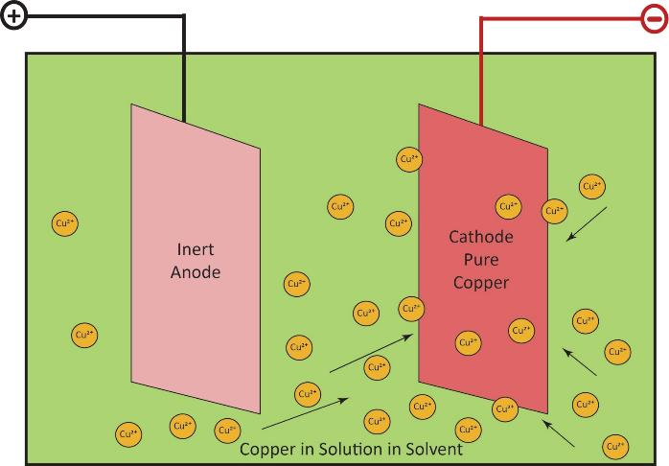
Electrowinning

Slide 73
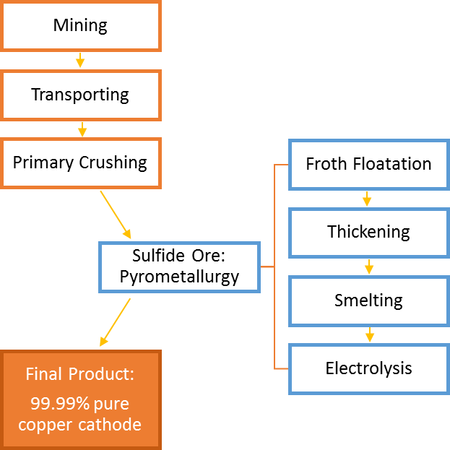
Processing of Sulfide Ore
(For example, Mission Mine)

Slide 74
Processing Copper Sulfide Ore
Sulfide ores are generally processed using pyrometallurgy
Mining considerations:
  Sulfide ore is often less abundant
  Pyrometallurgy process is more expensive
  Sulfide ore is often a higher-grade ore (contains more copper)
  Ultimately more copper can be extracted from sulfide ore deposits

Slide 75
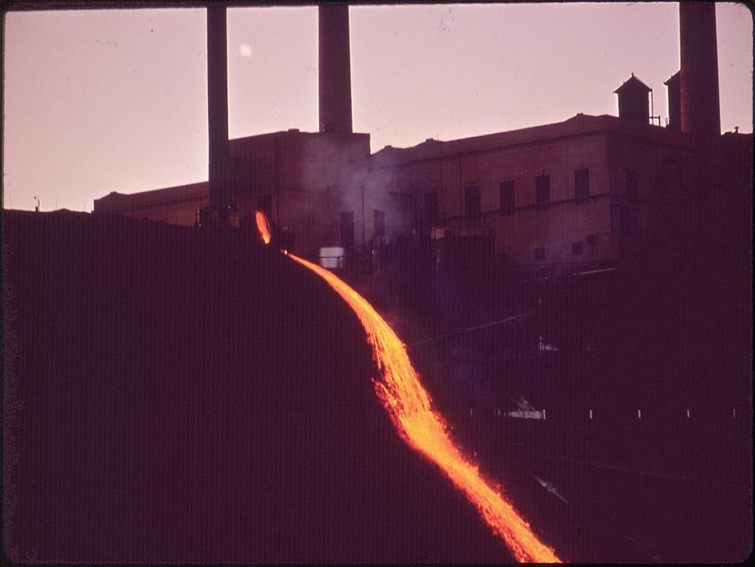
Pyrometallurgy
Uses physical steps and high temperatures to extract and purify copper from copper sulfide ores, usually in four steps:
  Froth flotation
  Thickening
  Smelting
  Electrolysis
Hot slag pours from smelter of Inspiration Consolidated Copper Company” by Keyes, Cornelius M. 1972. U.S. National Archives and Records Administration. Public Domain via Wikimedia Commons.

Slide 76
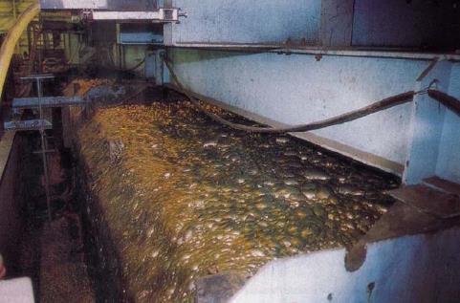
Froth Flotation
Crushed ore is further processed at a mill to fine sand
Liquid is added to make a slurry (copper ore and gangue)
Chemical reagents are added to bind the copper and make it waterproof
"Froth flotation" by Andreslan. Public Domain via Wikimedia Commons.

Slide 77
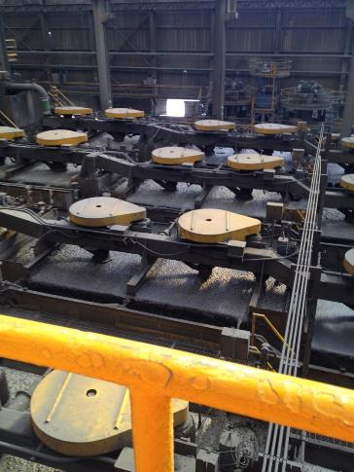
Froth Flotation
Air is blown into the slurry to make bubbles, which carry the waterproof copper to the top of the tank where it is skimmed off
Impurities drop to the bottom of the tank

Slide 78
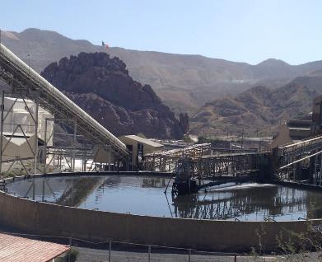
Thickening
Copper froth poured into large tanks (thickeners)
Bubbles break open, copper solids settle at the bottom
  Filtered to remove water
  Thickened copper concentrate contains metals, impurities and ~30% copper

Slide 79
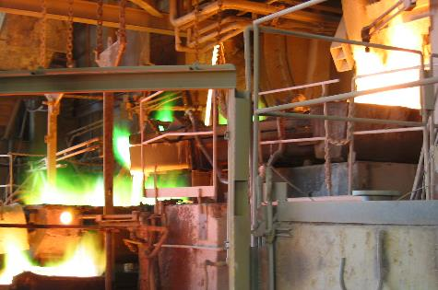
Smelting
  Copper concentrate is sent through the smelting furnace (2,300 °F)
  Converted into molten liquid
Liquid is poured into slag-settling furnace to produce:
  Matte: mixture of copper, sulfur, iron (~58-60% copper)
  Slag: dense, glassy material containing silica and other impurities

Slide 80
Smelting
Molten matte copper is sent to the converter furnace
  Impurities are burned off
  Forms yellow blister copper (98% copper)
Molten blister copper is sent to the anode smelter
  Oxygen is burned off, forming blue-green anode copper

Slide 81
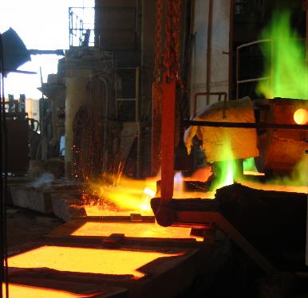
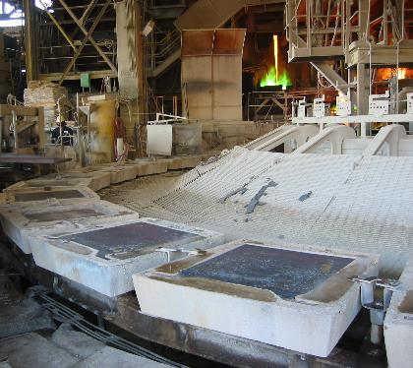
Smelting
Molten anode copper is poured into molds called anode-casting wheels
  Cooled anode slabs are 99% pure copper
    Now copper-colored
    2 inches thick, 3 feet wide, 3.5 feet high
    Weigh 750 pounds

Slide 82
Electrolysis
Anode slabs are hung in a large tank
  Act as positive electrodes
Thin sheets of pure copper (15 lb) are hung in between anodes
  Act as cathodes/negative electrodes
Tank is filled with electrolyte solution
  Copper sulfate and sulfuric acid

Slide 83
Electrolysis
Electric current is applied
Positively-charged copper ions (cations) leave the anode (positive electrode)
Cations move through the electrolyte solution and are plated on the cathode (negative electrode)

Slide 84
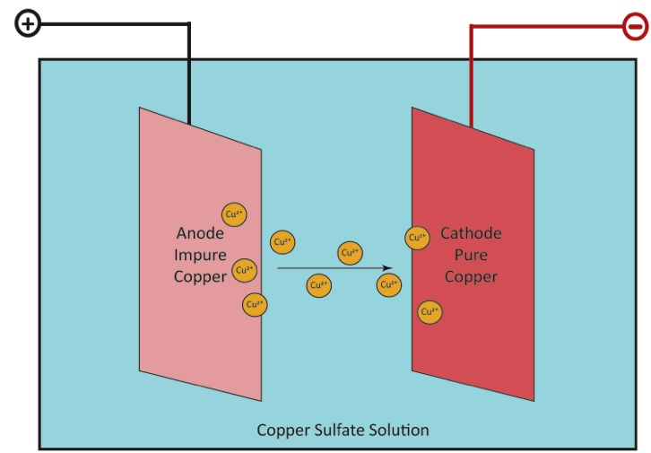
Electrolysis

Slide 85
Electrolysis
Other metals and impurities also leave the anodes
  Drop to the bottom of the tank or stay in solution
  Can be collected and refined to recover other valuable metals such as silver and gold
After 14 days of electrolysis, the final products are copper cathodes
  Weigh 375 pounds
  Contain 99.99% pure copper

Slide 86
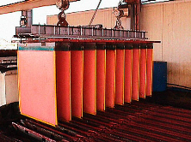
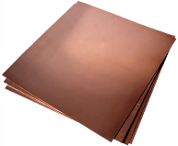
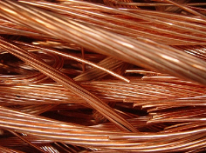
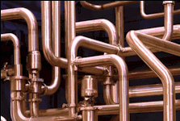
The finished copper cathodes can then be made into plates, wires, tubes, and other copper products.
Cathode
Plates
Wires
Tubes

Slide 87

Recycling Copper
Because copper is an element, it can be infinitely recycled
New and old copper scrap or copper alloys can be melted, re-purified, and recycled into new components
  ~50% of copper used in the copper industry was recycled
  In 2010, 770,000 metric tons of copper were recycled, at estimated value of $6 billion

