Slide 1
Pesticides
Human Health and the Environment

Slide 2
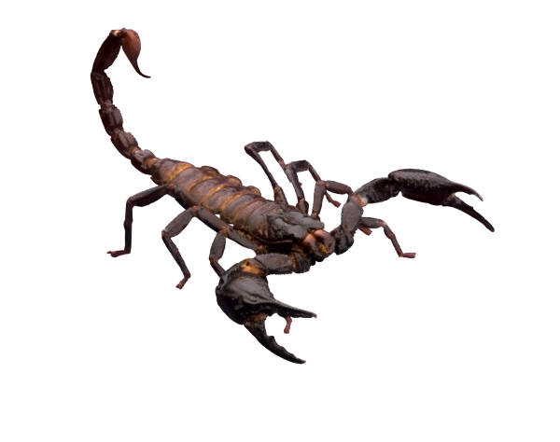
What is a Pesticide?
A pesticide is any substance or mixture of substances intended for:
Preventing,
Destroying,
Repelling, or
Mitigating
PESTS!

Slide 3
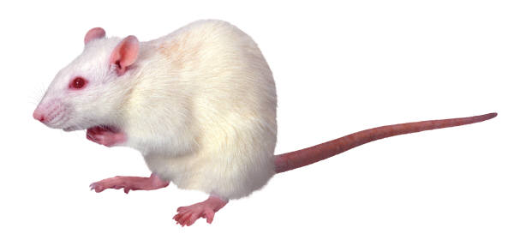
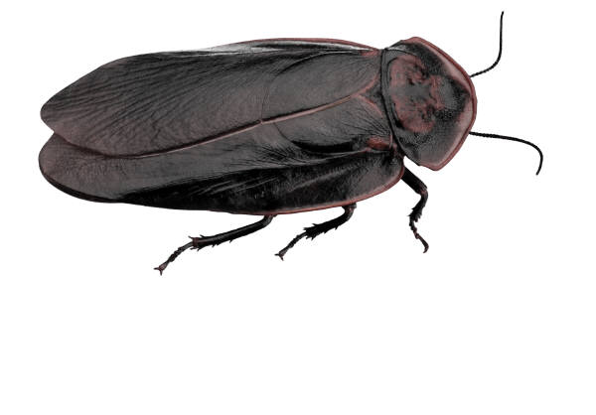
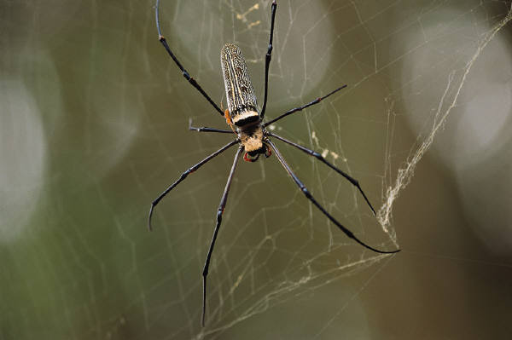
What is a Pest?
Living organisms that are not wanted and/or can cause damage to crops, humans or the environment
For example:
Insects, weeds, fungi, bacteria, viruses, mice, etc.

Slide 4
Types of Pesticides
Pesticides are often referred to according to the type of pest they control.
For example, insecticides kills insects; fungicides kills fungi (mold); herbicides kill plants, etc.
Another way to think about pesticides is in categories such as chemical pesticides, biopesticides or pest control devices.

Slide 5
Four Main Groups of Chemical Pesticides
Organophosphates:
Malathion, parathion, diazinon (Diazol®)
Carbamates:
Carbaryl (Sevin®), aldicarb (Termik®), methomyl (Lannate®)
Organochlorine:
DDT, chlordane
Pyrethroids:
Permethrin (Forte®), cypermethrin (Cypac®)

Slide 6
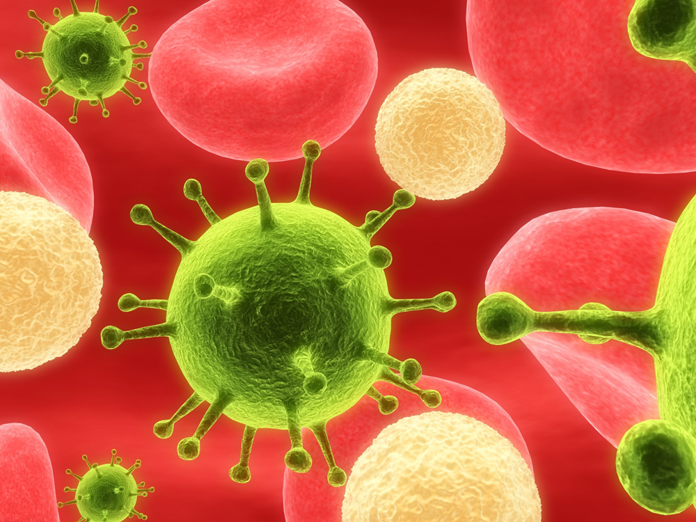
Biopesticides
Derived from natural materials such as animals, plants, bacteria, and minerals.
Examples:
Daisy - Pyrethrins and synthetic pyrethroids
Neem Tree - Azardiractrin
Others:
Microbial
Avermectin (Avid®, Agrimek®) produced by the microbe Streptomyces avermitis
Biochemical
Insect sex pheromones

Slide 7
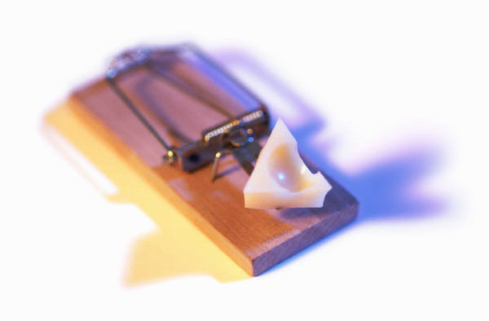
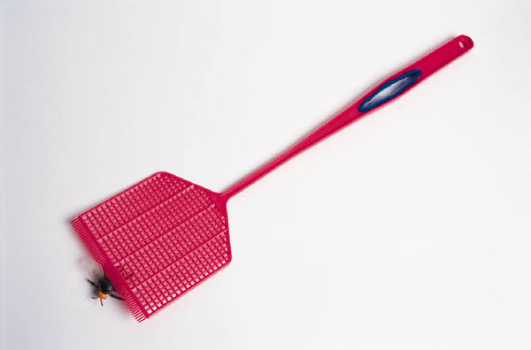
Pest Control Devices
Are products that use physical or mechanical means to trap, destroy, repel, or mitigate pests without chemical substances.
For example:
Black light traps
Fly traps
Ultraviolet light systems

Slide 8
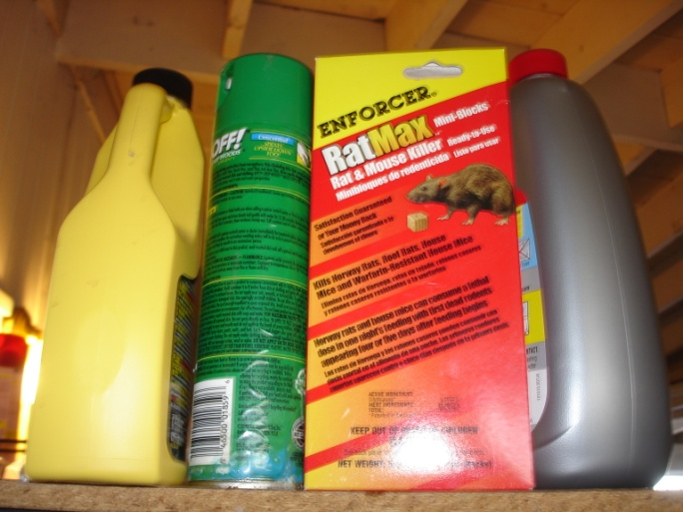
Pesticides: Human Health and the Environment
Most pesticides create some risk to human, animals, or the environment because they are designed to be toxic.
The US Environmental Protection Agency evaluates pesticides to ensure that they will not have an unreasonable adverse effects.
Many household products are pesticides!
Insect repellents
Rat and Rodent Poison
Weed killers

Slide 9
Risks of Pesticides
The US EPA uses a basic four step process to asses risk to human health:
1 Hazard Identification
What is the risk?
2
Dose-Response Assessment
“The Dose Makes the Poison”
3
Exposure Assessment
Inhalation, skin or oral exposure
4
Risk Characterization Combination of first 3 steps

Slide 10
Risks of Pesticides (cont.)
Hazard Identification
Identify the potential health effects from different types of pesticide exposure.
Dose-Response Assessment
The amount of a substance a person is exposed to, is as important as how toxic the chemical might be.
The Dose Makes the Poison

Slide 11
Risks of Pesticides (cont.)
Exposure Assessment
People can be exposed to pesticides by:
Inhalation
Skin absorption
Oral/Ingestion
Eyes
Risk Characterization
Combination of the first three steps to describe overall risk
RISK = Toxicity X Exposure

Slide 12
Potential Health Effects of Pesticides
According to the US EPA:
Depend on the type of pesticide.
Organophosphates and carbamates, affect the nervous system.
Others may irritate the skin or eyes.
They can also affect hormones in the body.
Some pesticides may be carcinogens.
US EPA human health risk assessment for many pesticides are available on the web.

Slide 13
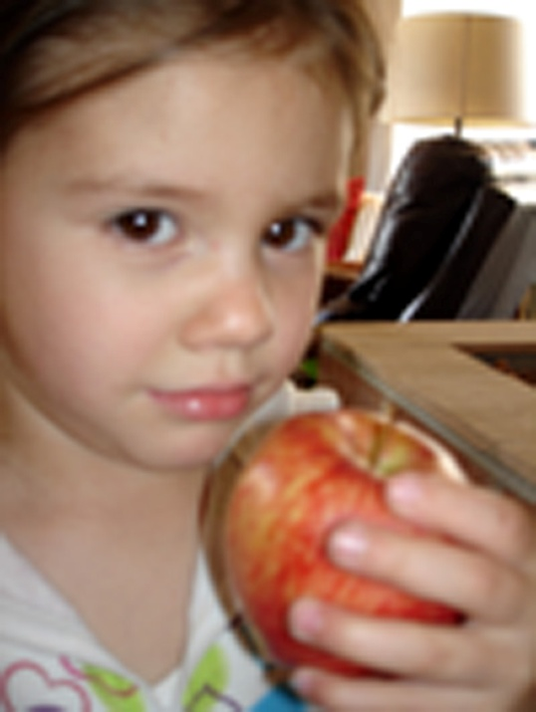
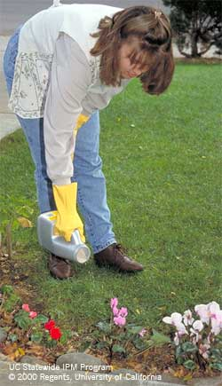
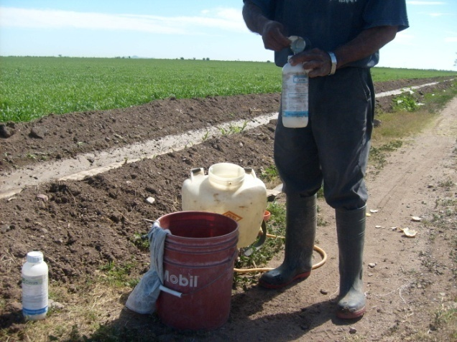
“The Dose Makes the Poison”

Slide 14
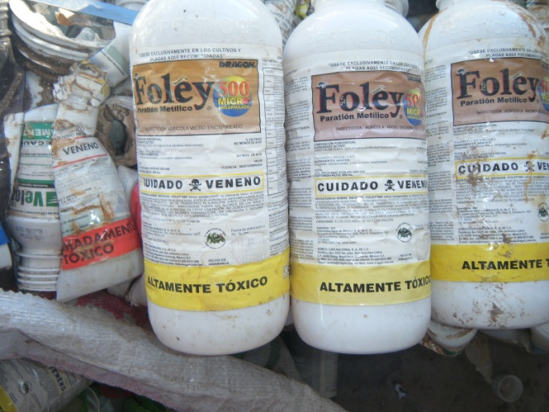
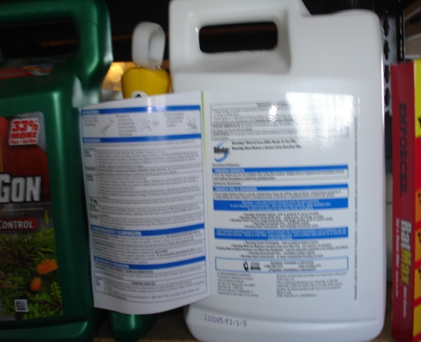
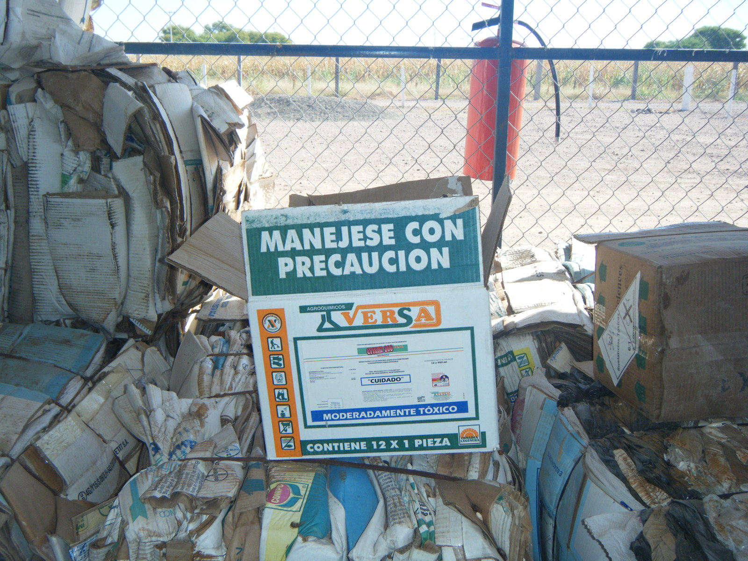
Pesticide Safety – The Label
Before you buy a product – READ THE LABEL!!!
PESTICIDE LABELS ARE LEGAL DOCUMENTS

Slide 15
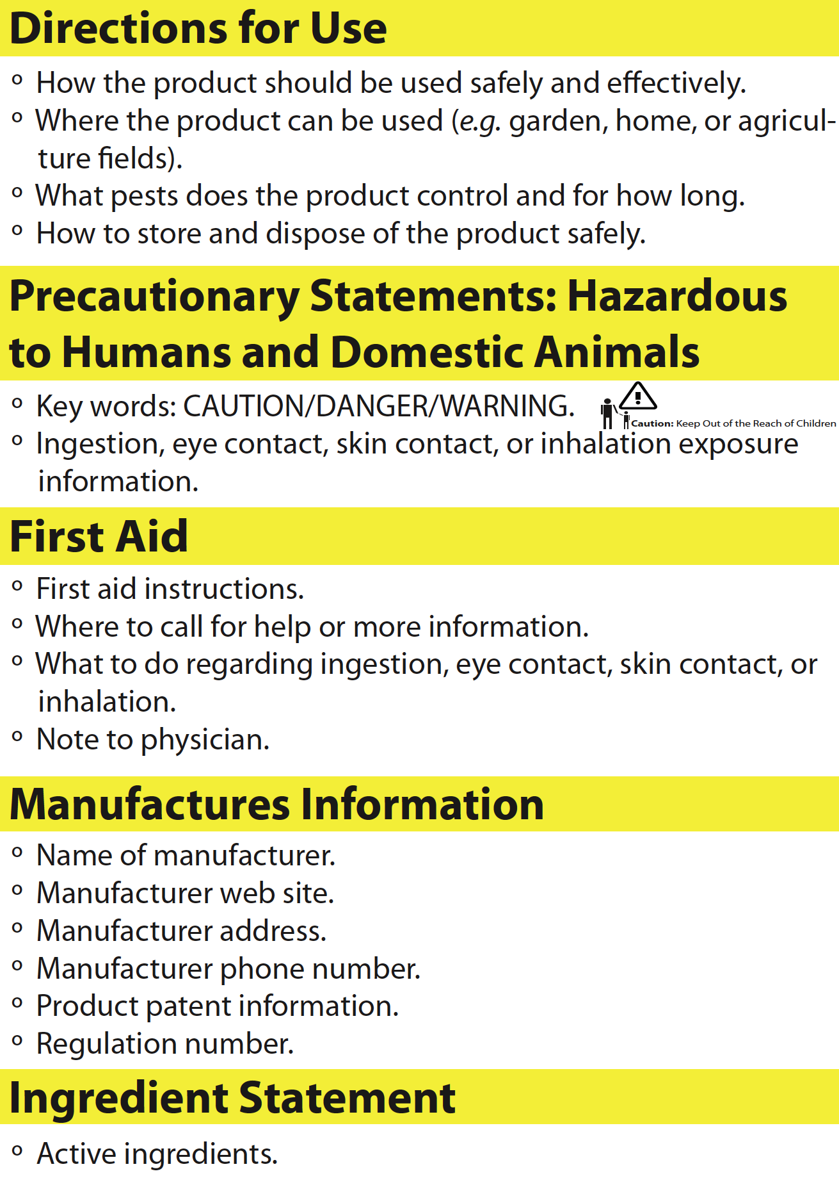
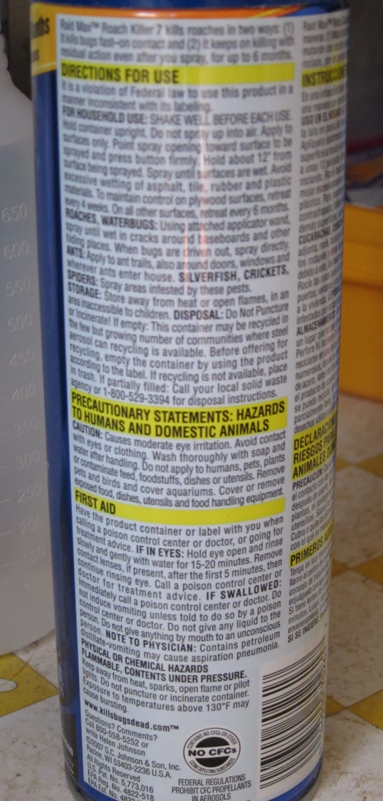
The Label Tells You…
How to use the product safely and effectively
How to store the product safely
First aid instructions
Where to call for help or more information

Slide 16
Signal Words and Images
Find the signal words in the label that tell you how poisonous the product is to animals and humans:
Caution – means least harmful to humans
Warning – means moderately hazardous
Danger – (skull and cross bones) means very poisonous or irritating (corrosive)
Should be used with extreme care

Slide 17
Signal Words
All labels have:
“Keep out of Reach of Children”
Many labels will also have a list of precautions such as:
“Remove and wash contaminated clothing before reuse”
“Do not store with food or livestock feed”
“Wash hands with soap and water after handling”

Slide 18
Signal Images

Slide 19
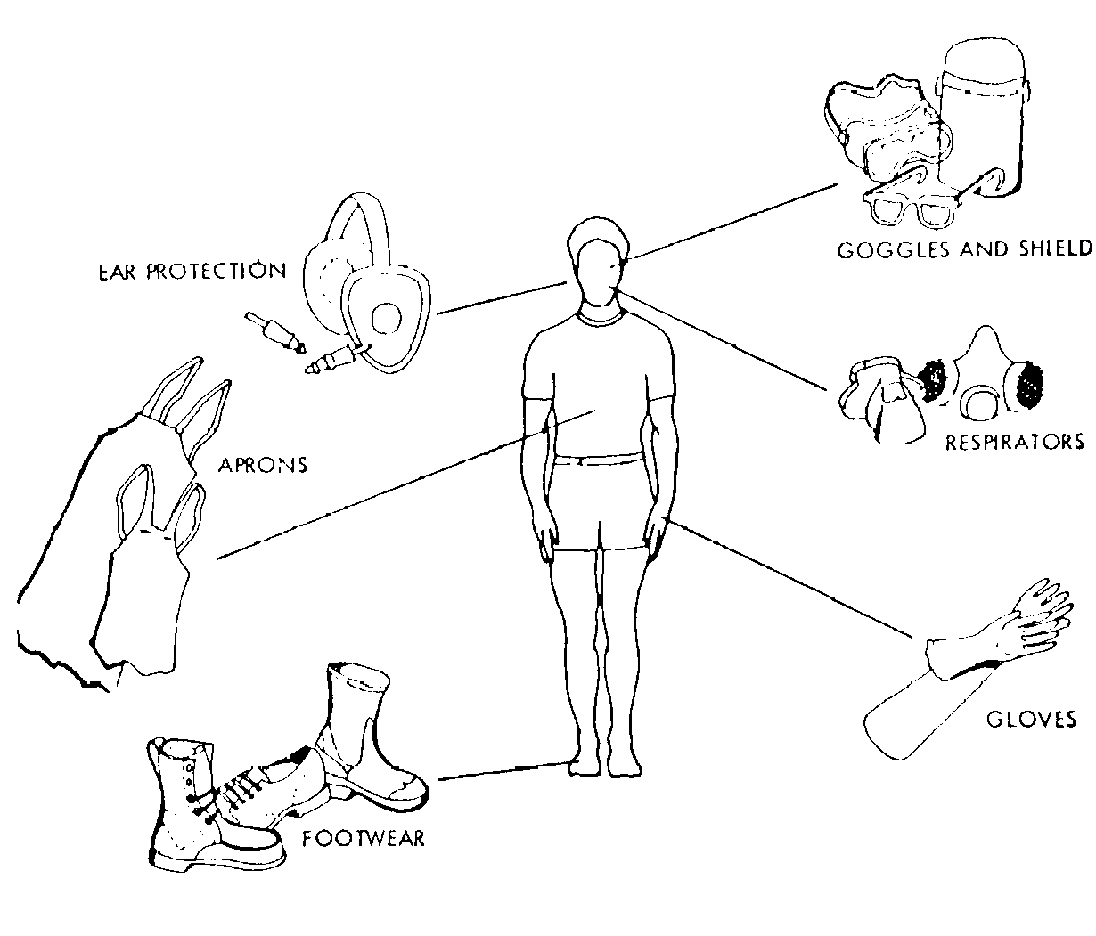
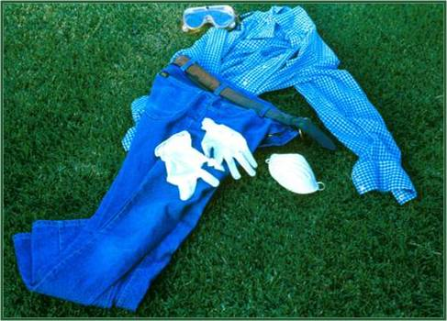
Personnel Protective Equipment
Field Worker PPE
Personal protection when using very poisonous or irritating pesticide formulas
http://web.princeton.edu/sites/ehs/labsafetymanual/sec6c.htm
Home Application PPE
http://pesticidestewardship.org

Slide 20
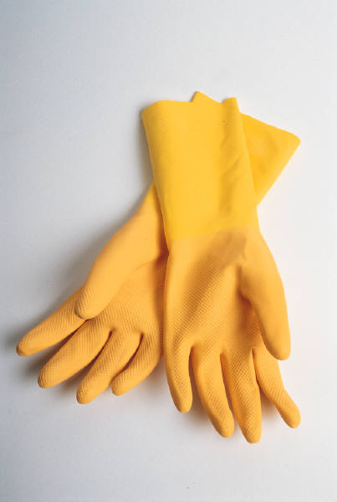
Personal Protective Equipment
Protect your hands
Chemical resistant glove (available at home improvement stores)
Hands are the mostly likely exposed when applying pesticides at home
Protective clothing
Use long sleeve shirt and long pants
Eye protection
Use glasses or goggles

Slide 21
Alternatives to Using Pesticides
Sometimes a non-chemical method of pest control is as effective and convenient as a chemical pesticide.
Alternative pest control methods include:
Pest prevention
Non-chemical pest controls

Slide 22
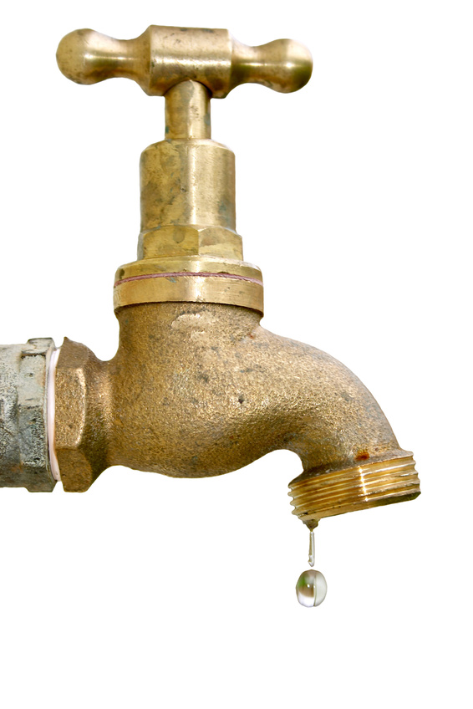
Pest Prevention
Eliminate food sources
Store food, do not leave dirty dishes, put lid on garbage, clean cooking grease in kitchen, remove pet’s waste frequently
Eliminate water sources
Repair leaks, remove standing water, dispose of water damage material
Eliminate hiding places
Do away with piles of paper, repair holes or crevices, trim vegetation and shrub

Slide 23
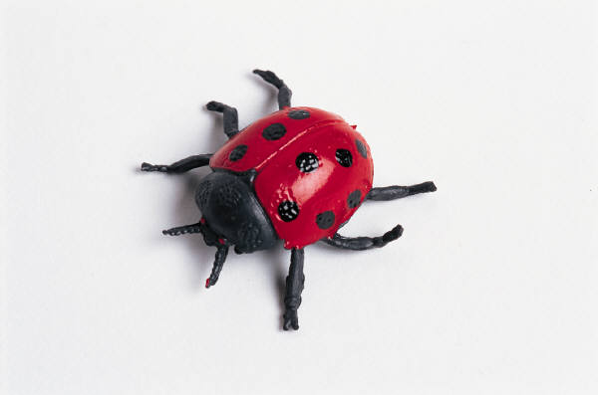
Non-Chemical Pest Controls
Glue traps or tape
Insects and rodents
Traps
Insects and rodents
Beneficial predators
Ladybugs, cats
Vacuuming
Insects

Slide 24
Other Less Toxic Pest Controls
Canola oil and baking soda
Fungus (mold)
Boric acid
Cockroaches and ants
Citronella oil
Insects
Soap and water solution
Insects
Neem tree oil
Scabies, ticks, fleas, lice, and mites

Slide 25
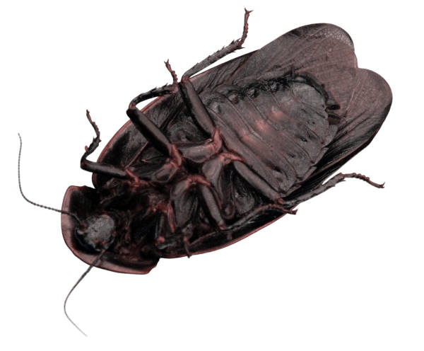
Integrated Pest Management
Combines all available methods for a most effective strategy to control pests.
The steps are:
Monitor and identify
Action Threshold
Prevention
Control

Slide 26
Integrated Pest Management
Monitor and Identify
Identify and monitor the pest problem
Action Threshold
Decide how much pest control is needed and choose effective option
Prevention
Prevent pest by inspecting indoors and outdoors
Control
Evaluate results

Slide 27
How to Decrease Exposure to Pesticides

Slide 28
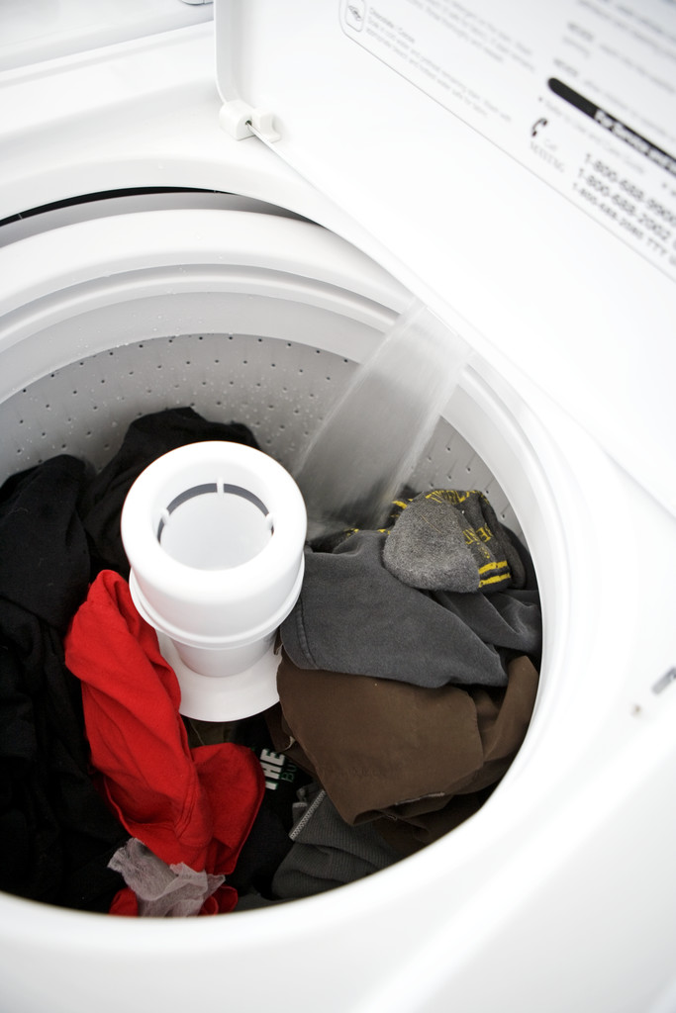
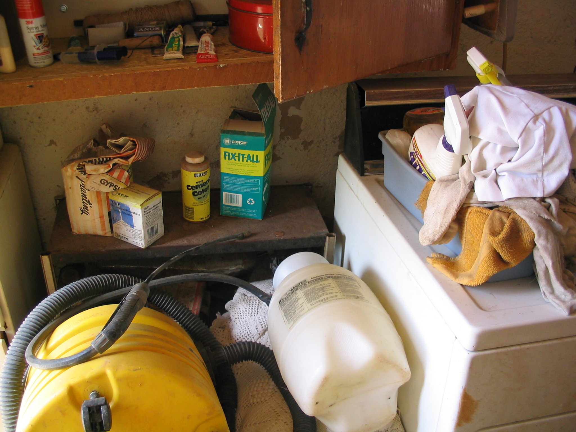
Remove Contaminated Clothes, Wash Clothes Separately
Separate and Store Away from Clothes

Slide 29
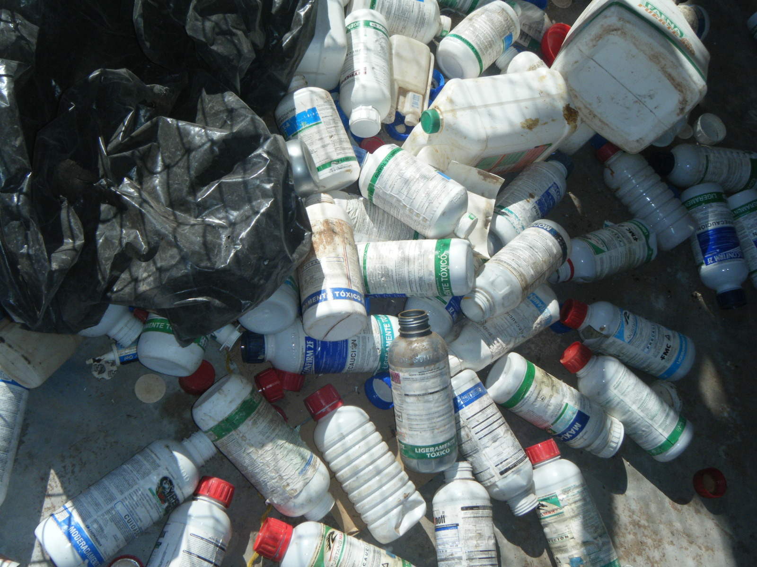
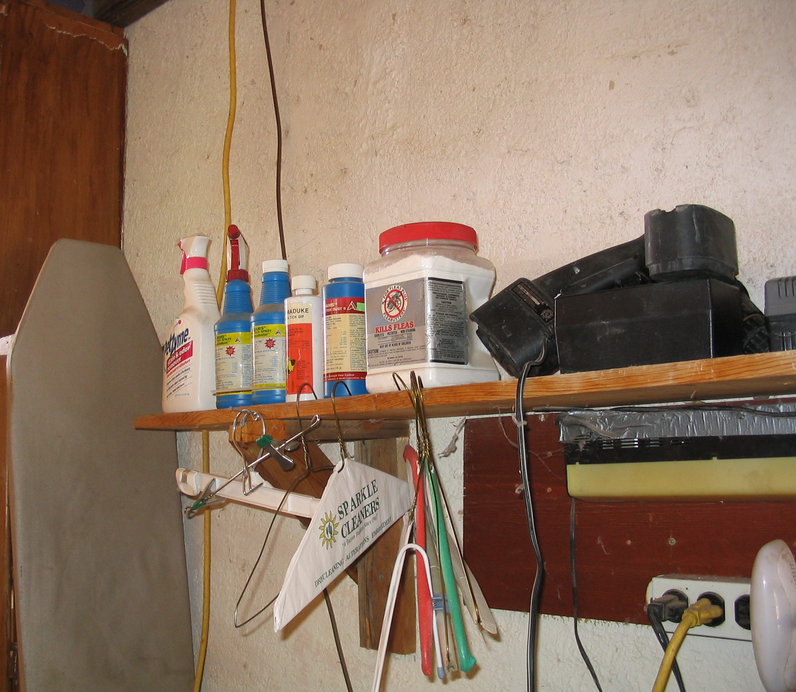
Puncture and Make Unusable the Containers
Separate and Keep Away from Children

Slide 30
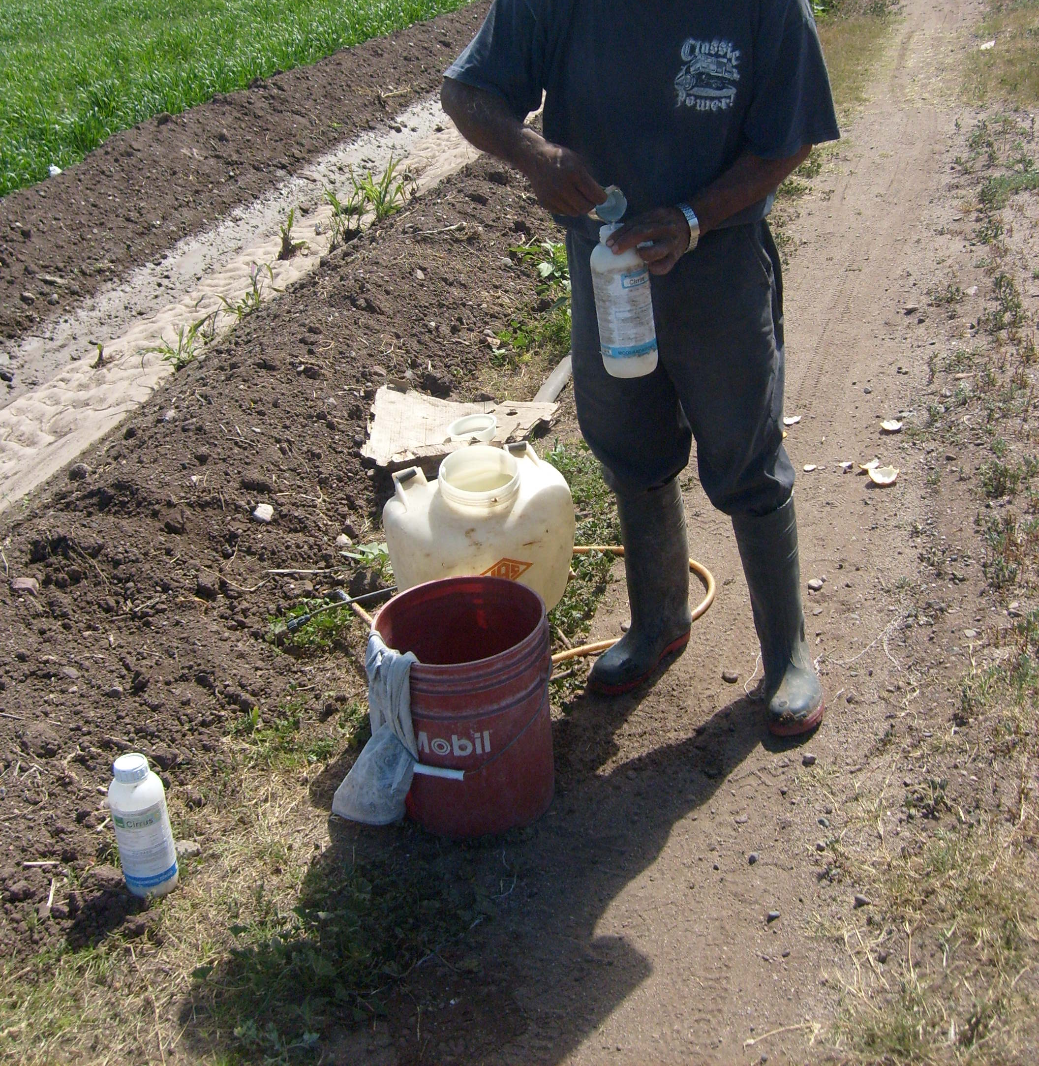
Have Good Ventilation
Wear Protection

